Slide 1

Slide 1
DATA BREWERIES
Presentation
PHILIP TRAXLER
ZACHARY HARRIS
LINDA URRUTIA

Slide 2
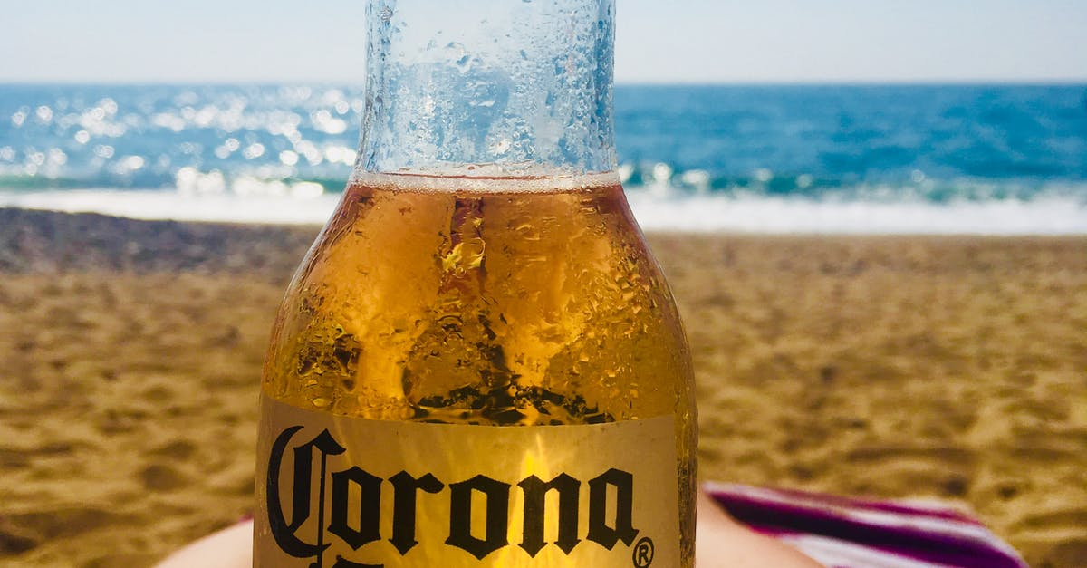
PRESENTATION ITEMS
Number of Breweries in the United States
Addressing missing values
Median alcohol content
Median international bitterness unit
State with the maximum alcoholic & most bitter beer
Alcohol by volume distribution
Summary stats and distribution of ABV variable
Scatter plot on apparent relationship between bitterness of beer and alcohol content
Additional methods used to investigate differences

Slide 3
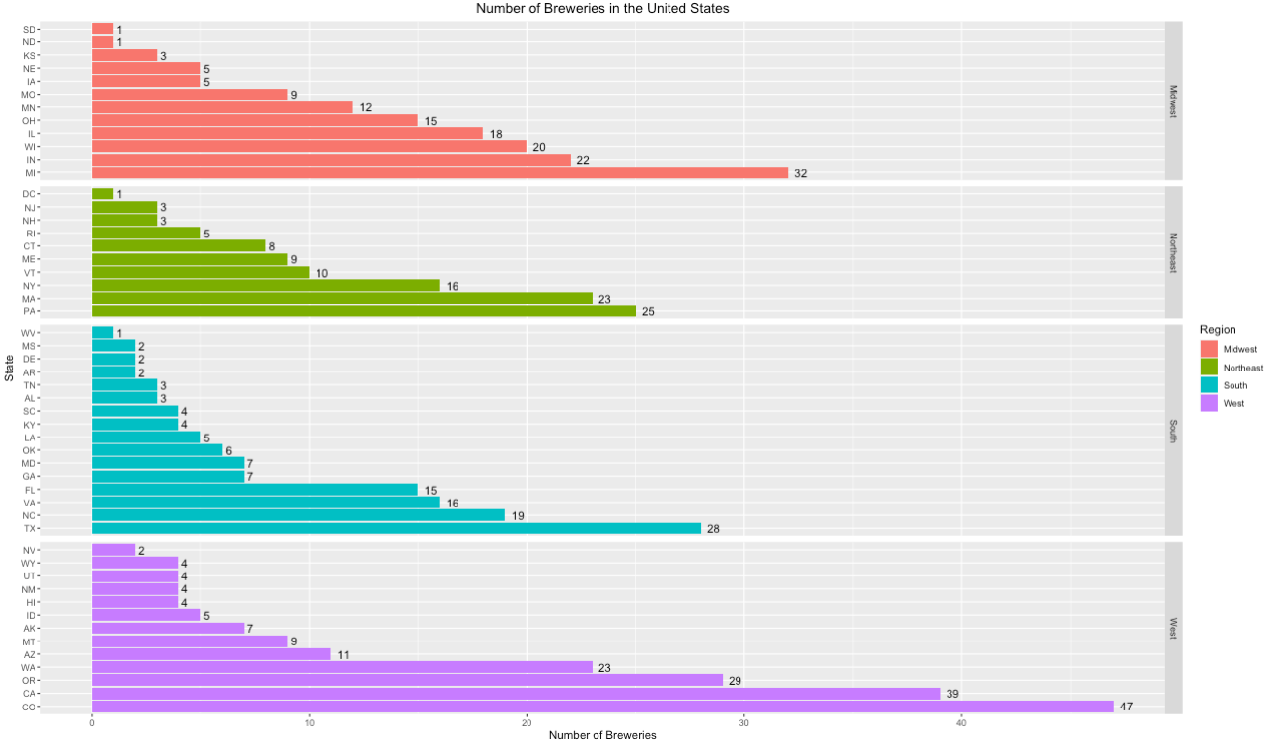
Slide 2
NUMBER OF BREWERIES IN THE U.S.
1

Slide 4

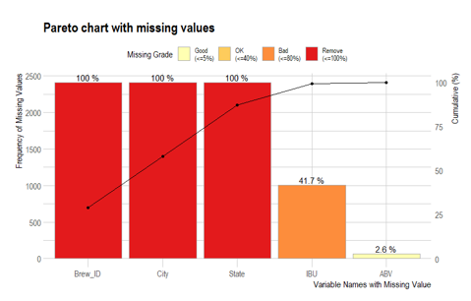
Slide 2
ADDRESSING MISSING VALUES
2
This Photo by Unknown Author is licensed under CC BY-SA-NC

Slide 5
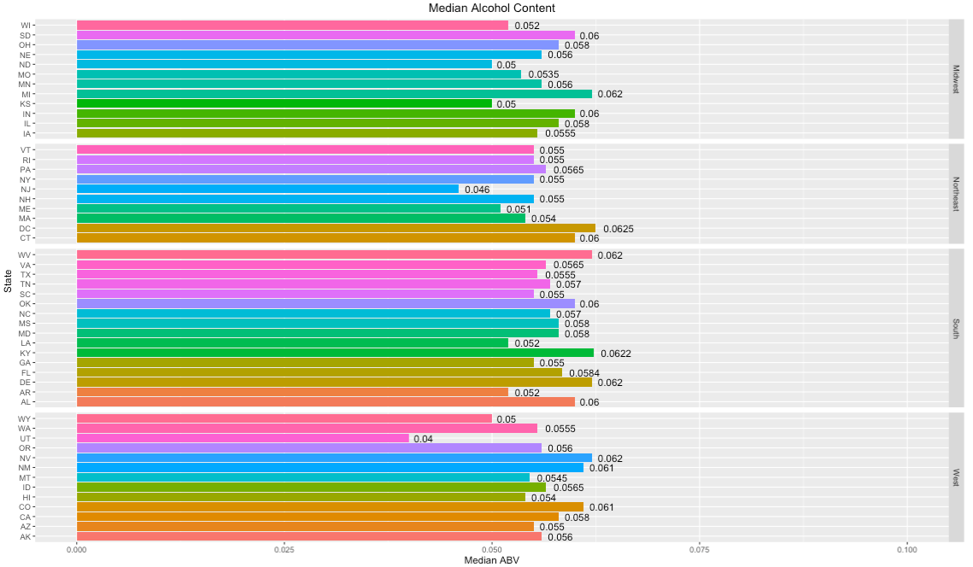
Slide 2
MEDIAN ALCOHOL CONTENT
3

Slide 6
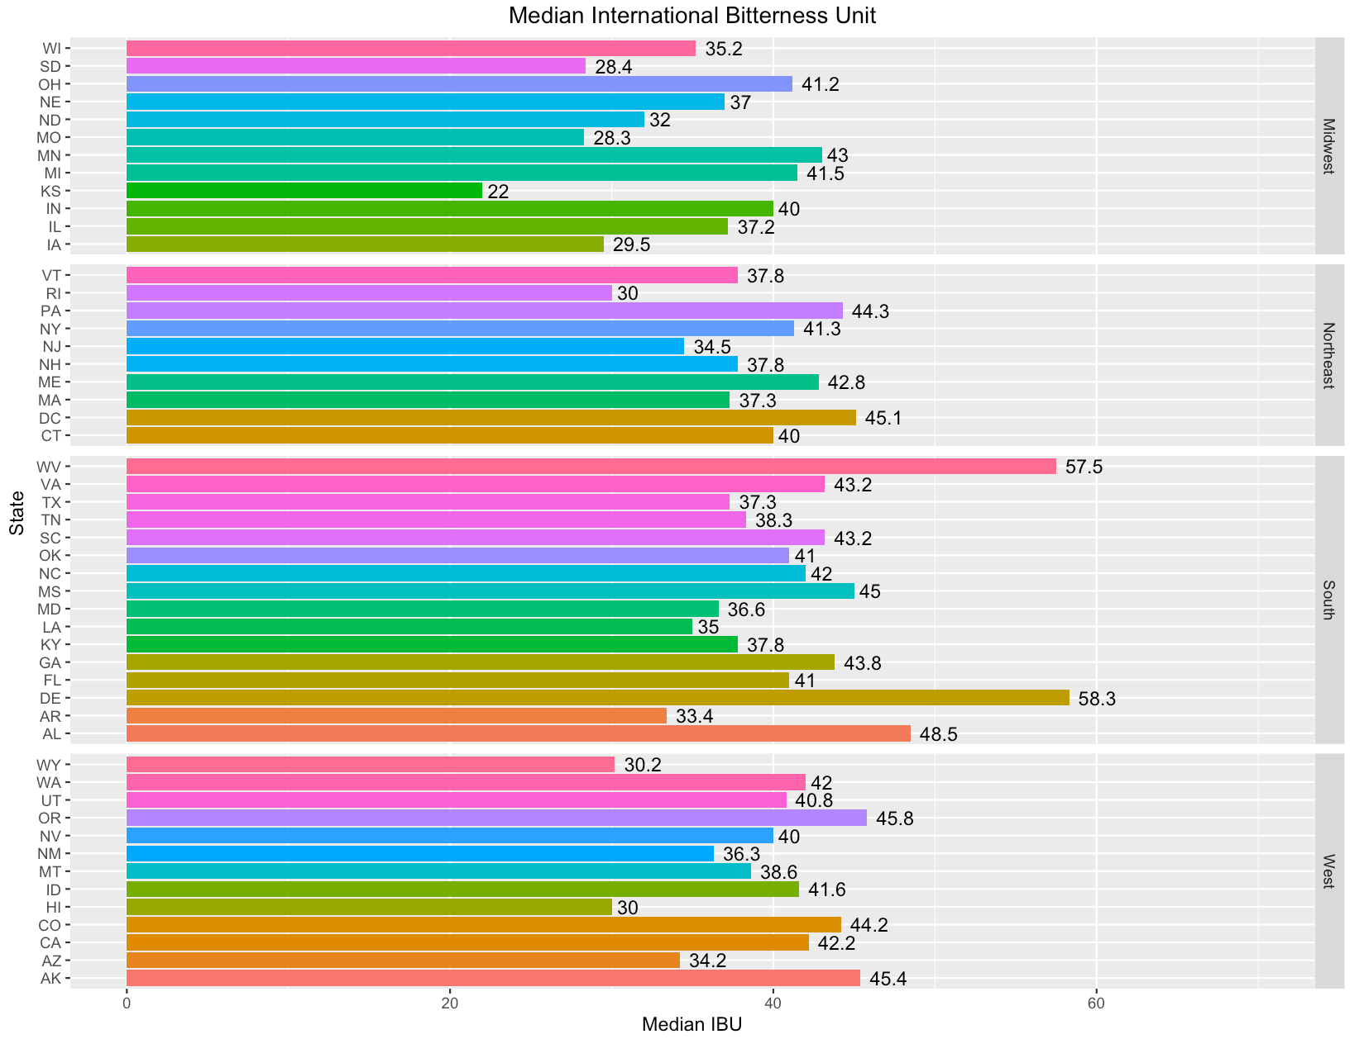
Slide 2
MEDIAN INTERNATIONAL BITTERNESS UNIT
4

Slide 7
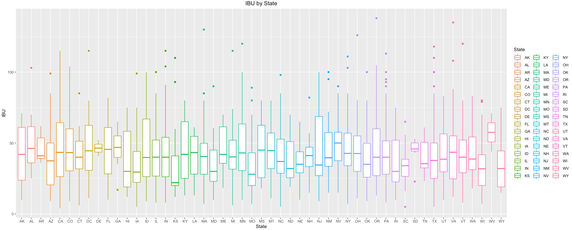
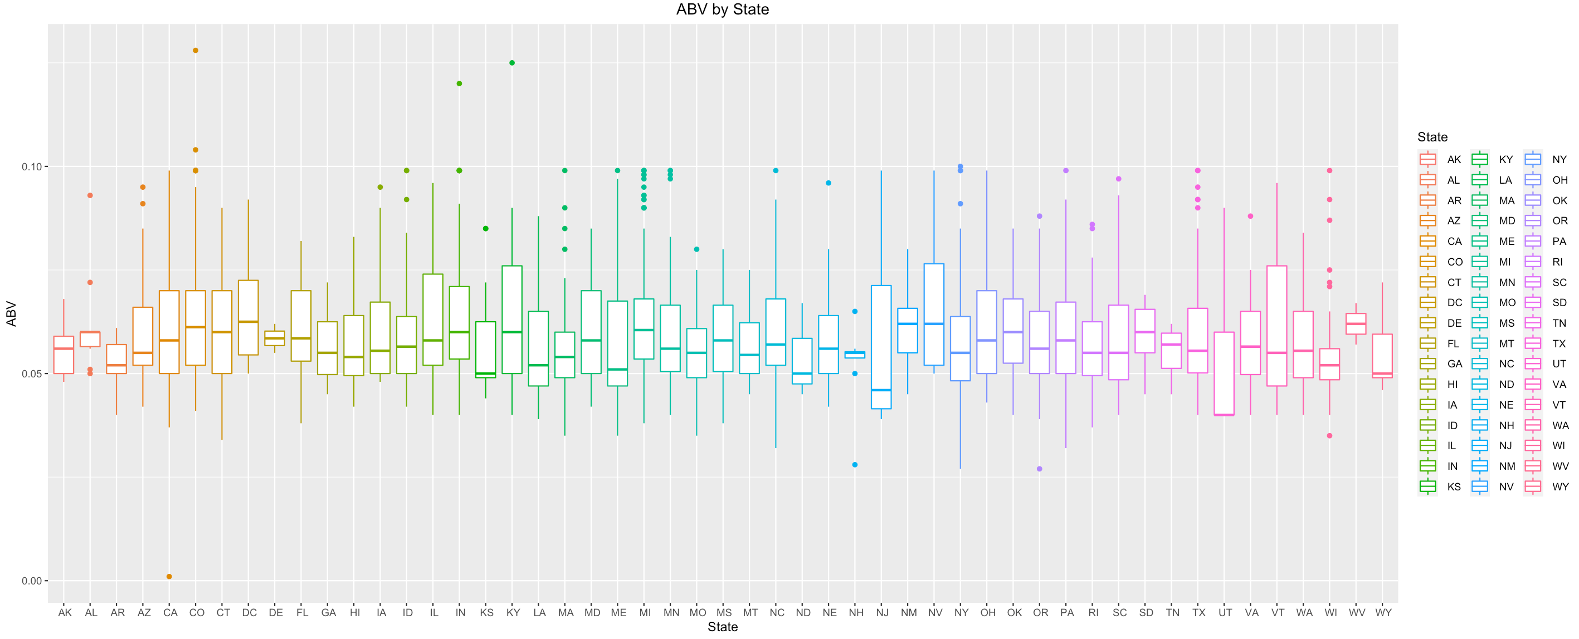
Slide 2
STATE WITH MAXIMUM ALCOHOLIC & MOST BITTER BEER
5

Slide 8
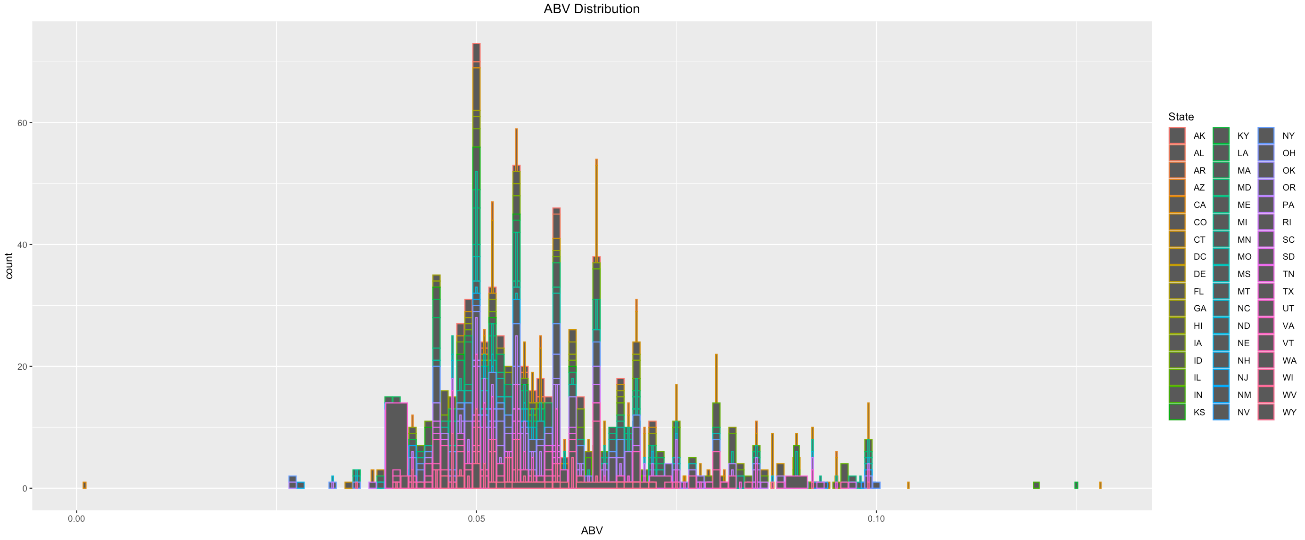
Slide 2
ALCOHOL BY VOLUME DISTRIBUTION
6

Slide 9
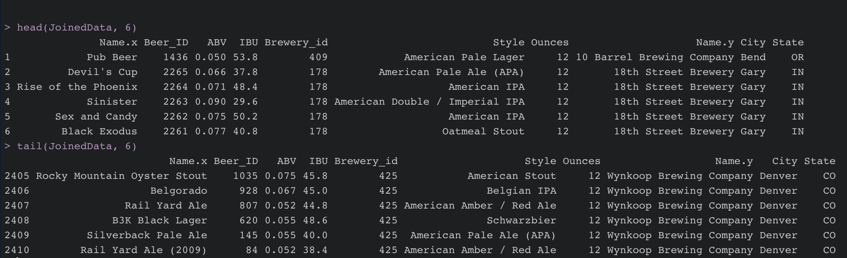
Slide 2
DATA SUMMARY
7

Slide 10
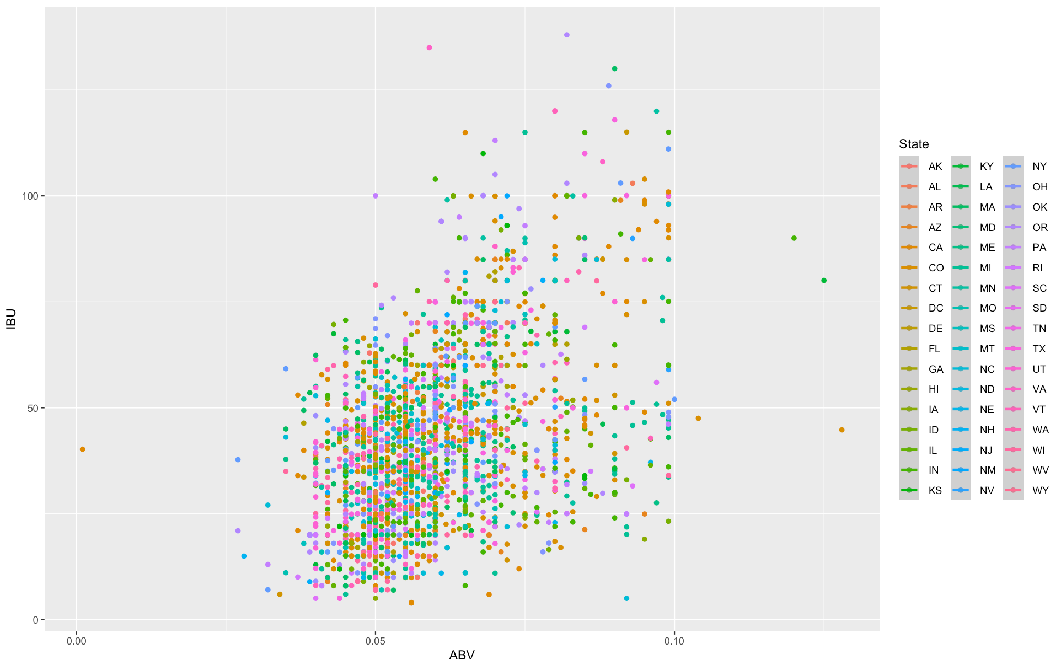
Slide 2
ABV VS IBU
2

Slide 11
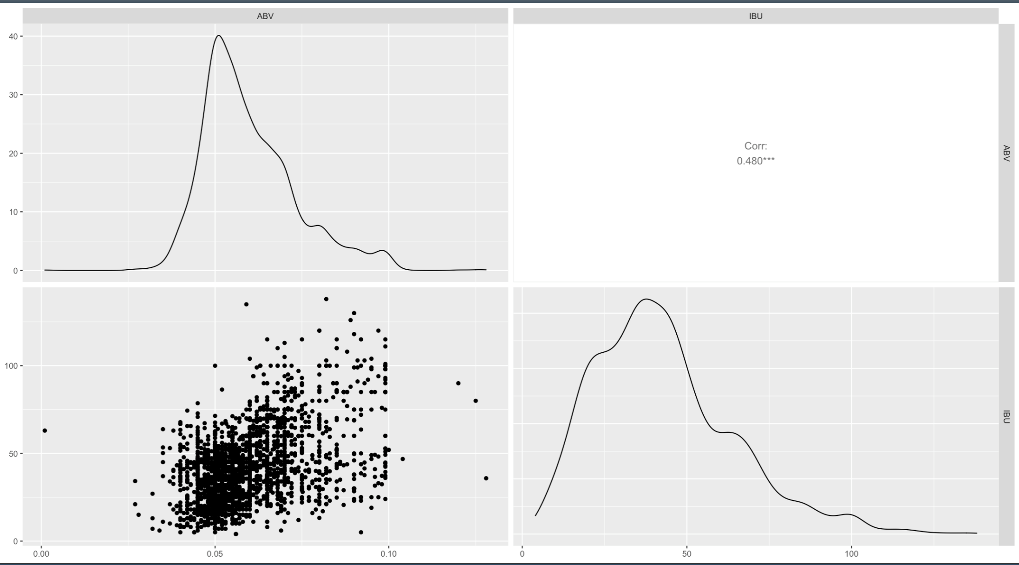
Slide 2
ABV & IBU RELATIONSHIP
8

Slide 12
Slide 2
kNN
9

Slide 13
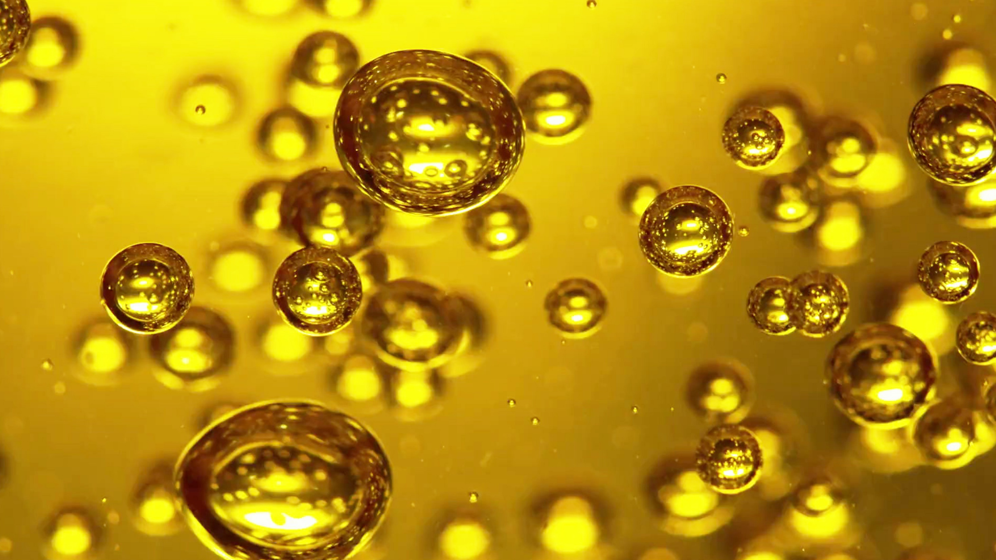
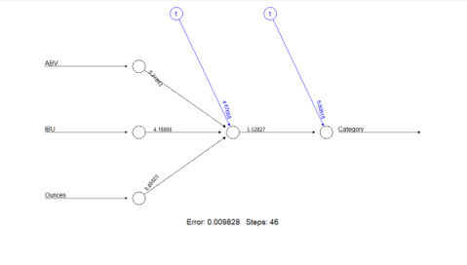
Slide 2
MULTI LAYER NEURAL NETWORK
10

Slide 14
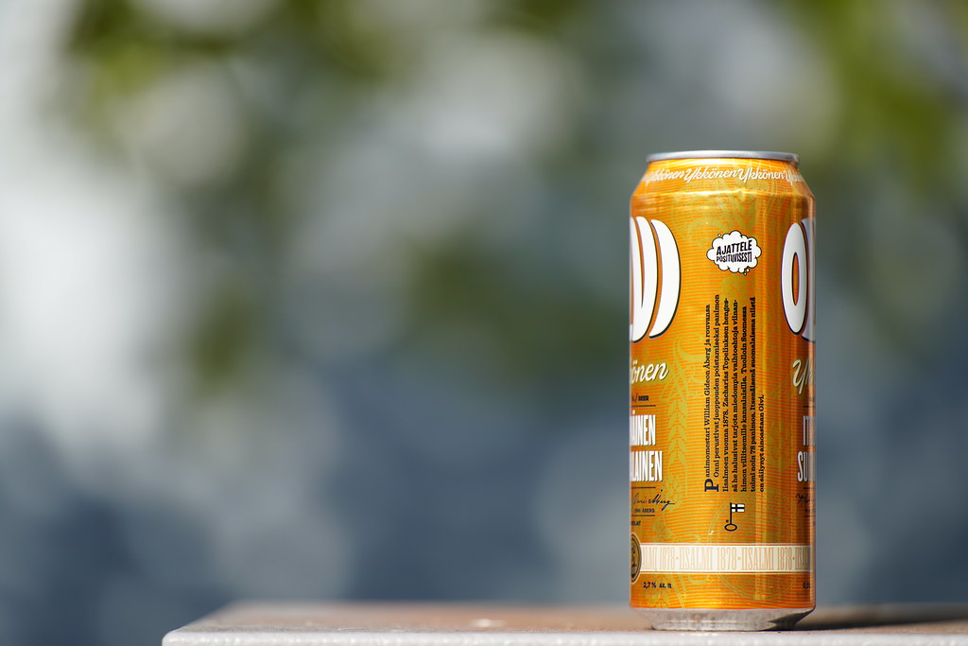
Slide 2
MULTI LINEAR REGRESSION
11
This Photo by Unknown Author is licensed under CC BY

Slide 15
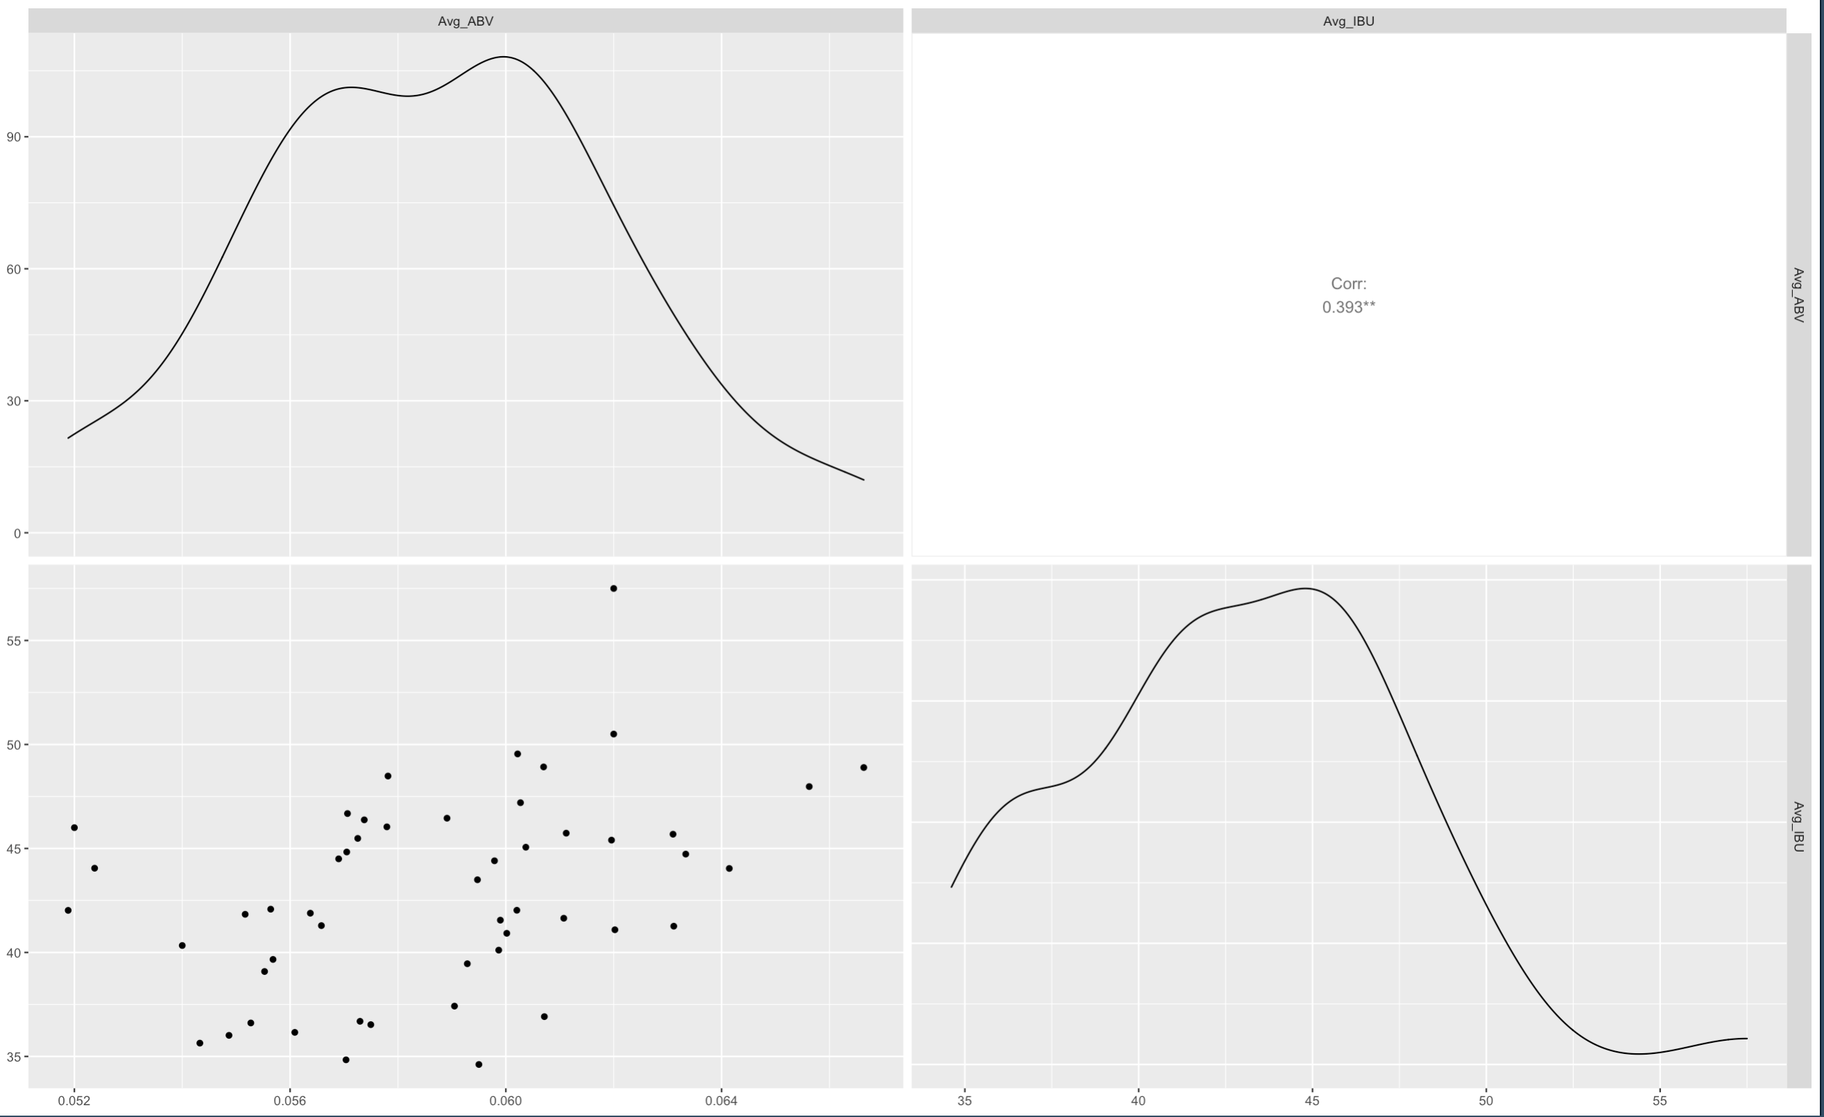
Slide 2
ABV & IBU RELATIONSHIP
12

Slide 16
Slide 2
ABV & IBU RELATIONSHIP
ABV
IBU
13

Slide 17
Slide 1
Significant Libraries and Packages
library(dlookr)
library(visdat)
library(plotly)
library(missRanger)
library(ggplot2)
library(magrittr)
library(ranger)
library(dplyr)
library(class)
library(caret)
library(e1071)
library(GGally)
library(stringi)
library(stringr)
library(xgboost)
library(car)
library(Matrix)
library(keras)
library(forecast)
library(neuralnet)

Slide 18

Slide 11
THANK YOU

